Slide 1
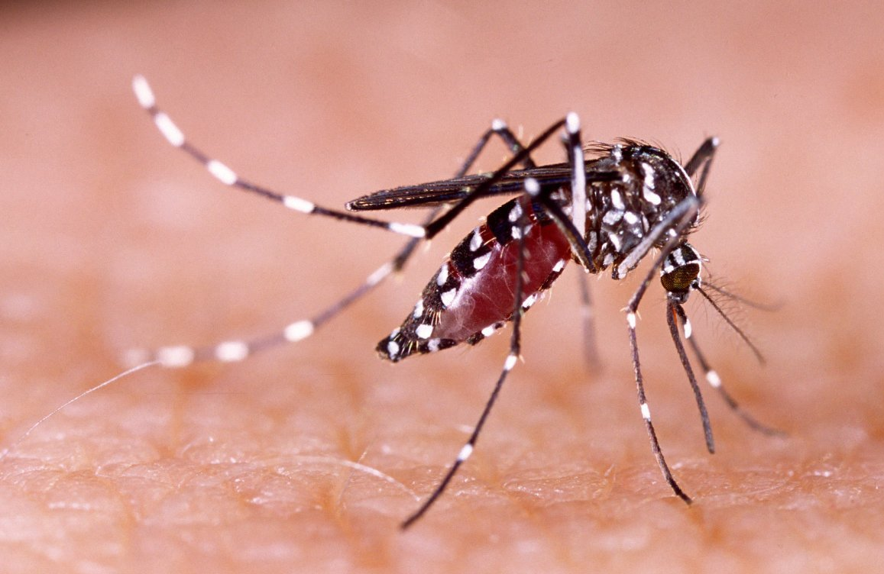
Temperature sensitivity of Dengue in Thailand
Project Proposal
Thaddeus Kühn, Dana Levi, Fiona Tanner, Frederik Racky
https://www.wissenschaft.de/wp-content/uploads/2/0/20-01-17-dengue.jpg

Slide 2
Overview
Background Data
Methods Milestones
Ideas Timeline

Slide 3
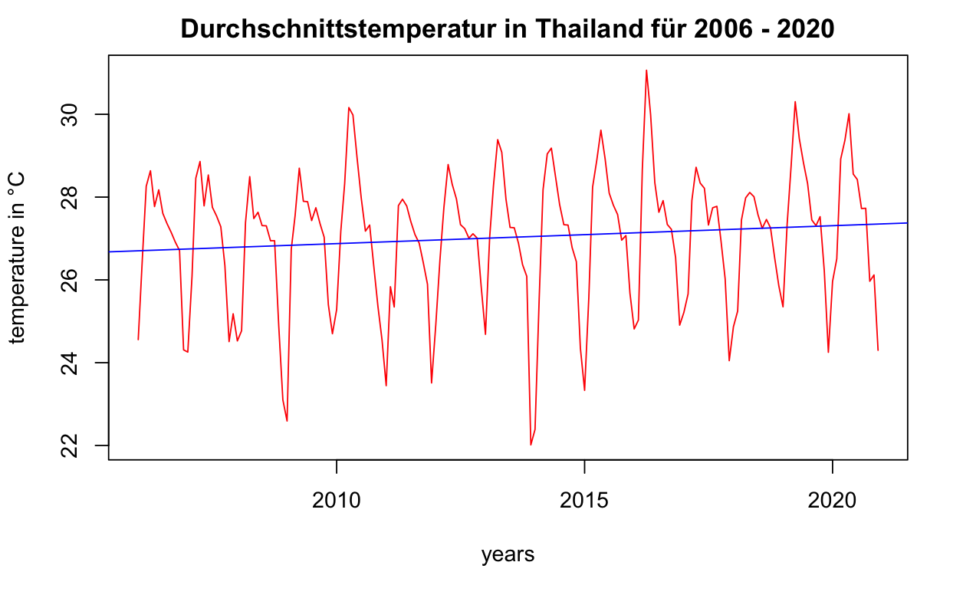
Climate
Dry winter
Monsoon
Dry winter
May
October
Notes:
Masud et al. Investigated climate in northern thailand -> Trends: rising min and max temperature in northern thailand, no significant rise in max in spring

Slide 4
Dengue

Slide 5
Datasets
TEMPERATURE
ERA5 database
Monthly 2m temperature
2006 - 2022
DENGUE
DHF data
Total monthly infections per district 2006 - 2020
POPULATION
Notes:
ERA5 Data:
measurements, reanalysis of climate data since 1959 (hourly, 0,25°x 0,25° spatial resolution, 137 altitude levels (max. 80 km)
Extraction of monthly 2m temperature data from 2006 – 2022
Dengue data:
Dengue hemmorhagic fever
Monthly infections in every thailand province (77)

Slide 6
Further investigation ideas
How does temperature affect dengue mortality?
How do urbanized areas affect infection rates

Slide 7
Sources
Masud, M. B., Soni, P., Shrestha, S., & Tripathi, N. K. (2016). Changes in climate extremes over North Thailand, 1960–2099. Downloads.Hindawi.Com, 1960–2099.

